Slide 1
VE281 Data Structures and Algorithms
Non-comparison Sort
Learning Objective:
Understand three non-comparison sorts, counting sort, bucket sort, and radix sort

Slide 2
Announcements
VM environments will be released this weekend.
Check it out! Let me and TAs know if you run into problems!
HW Grading.
Recitation class will be scheduled some time next week.
Check Canvas announcements!
Tell your friends!
Homework will be graded as how many mistakes you make!
Each question worth 20%.
100% == no mistakes!
5 mistakes == no points! (there are extra (hard) questions to amend your mistakes)
I recommend taking the Quiz over the take-home assignment!
Your take-home grade over-writes your quiz grade!
Do not spam the Quiz opportunity!
Take-home assignments are still fun!
I recommend checking it out!

Slide 3
Outline
Non-comparison Sort
Counting Sort
Bucket Sort
Radix Sort

Slide 4
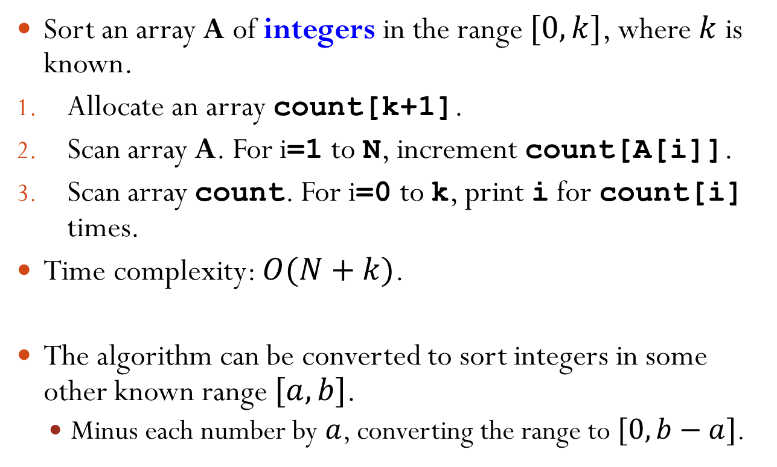
Counting Sort A Simple Version
Sort an array A of integers in the range $[0, k]$, where $k$ is known.
Allocate an array count[k+1].
Scan array A. For i=1 to N, increment count[A[i]].
Scan array count. For i=0 to k, print i for count[i] times.
Time complexity: $O(N+k)$.
The algorithm can be converted to sort integers in some other known range $[a, b]$.
Minus each number by $a$, converting the range to $[0, b−a]$.
Notes:
Example: 0, 2, 3, 1, 0, 2, 0, 3

Slide 5
Example
2 | 5 | 3 | 0 | 2 | 3 | 0 | 3

Slide 6
Counting Sort A General Version
In the previous version, we print i for count[i] times.
Simple but only works when sorting integer keys alone.
How to sort items when there is “additional” information with each key? Furthermore, how to guarantee the stability?
A general version:
Allocate an array C[k+1].
Scan array A. For i=1 to N, increment C[A[i]].
For i=1 to k, C[i]=C[i-1]+C[i]
C[i] now contains number of items less than or equal to i.
For i=N downto 1, put A[i] in new position C[A[i]] and decrement C[A[i]].
Notes:
(1, a) (2, b) (1, c) (3, d) (2, e)?

Slide 7
Counting Sort Example
k=5
1 | 2 | 3 | 4 | 5 | 6 | 7 | 8
Allocate an array C[k+1].
Scan array A. For i=1 to N, increment C[A[i]].
For i=1 to k, C[i]= C[i-1]+C[i]
For i=N downto 1, put A[i] in new position C[A[i]] and decrement C[A[i]].
A
2 | 5 | 3 | 0 | 2 | 3 | 0 | 3
0 | 1 | 2 | 3 | 4 | 5
C
2 | 0 | 2 | 3 | 0 | 1
0 | 1 | 2 | 3 | 4 | 5
C
2 | 2 | 4 | 7 | 7 | 8

Slide 8
Counting Sort Example
k=5
1 | 2 | 3 | 4 | 5 | 6 | 7 | 8
Allocate an array C[k+1].
Scan array A. For i=1 to N, increment C[A[i]].
For i=1 to k, C[i]= C[i-1]+C[i]
For i=N downto 1, put A[i] in new position C[A[i]] and decrement C[A[i]].
A
2 | 5 | 3 | 0 | 2 | 3 | 0 | 3
0 | 1 | 2 | 3 | 4 | 5
C
2 | 2 | 4 | 7 | 7 | 8
1 | 2 | 3 | 4 | 5 | 6 | 7 | 8
3
0 | 1 | 2 | 3 | 4 | 5
C
2 | 2 | 4 | 6 | 7 | 8
Why putting 3 at location 7 is correct?
Notes:
Why correct? Because, from the initial C array, we can see that 3 should be put at indices 5, 6, and 7.
Note here 6 indicates the position for the next 3 that will be visited.

Slide 9
Counting Sort Example
k=5
1 | 2 | 3 | 4 | 5 | 6 | 7 | 8
Allocate an array C[k+1].
Scan array A. For i=1 to N, increment C[A[i]].
For i=1 to k, C[i]= C[i-1]+C[i]
For i=N downto 1, put A[i] in new position C[A[i]] and decrement C[A[i]].
A
2 | 5 | 3 | 0 | 2 | 3 | 0 | 3
0 | 1 | 2 | 3 | 4 | 5
C
2 | 2 | 4 | 6 | 7 | 8
1 | 2 | 3 | 4 | 5 | 6 | 7 | 8
 |  |  |  |  |  | 3
0
0 | 1 | 2 | 3 | 4 | 5
C
1 | 2 | 4 | 6 | 7 | 8

Slide 10
Counting Sort Example
k=5
1 | 2 | 3 | 4 | 5 | 6 | 7 | 8
Allocate an array C[k+1].
Scan array A. For i=1 to N, increment C[A[i]].
For i=1 to k, C[i]= C[i-1]+C[i]
For i=N downto 1, put A[i] in new position C[A[i]] and decrement C[A[i]].
A
2 | 5 | 3 | 0 | 2 | 3 | 0 | 3
0 | 1 | 2 | 3 | 4 | 5
C
1 | 2 | 4 | 6 | 7 | 8
1 | 2 | 3 | 4 | 5 | 6 | 7 | 8
3
 | 0 |  |  |  |  | 3
0 | 1 | 2 | 3 | 4 | 5
C
1 | 2 | 4 | 5 | 7 | 8
Notes:
At this moment, you can see that we are sorting two 3’s and their order is kept

Slide 11
Counting Sort Example
k=5
1 | 2 | 3 | 4 | 5 | 6 | 7 | 8
Allocate an array C[k+1].
Scan array A. For i=1 to N, increment C[A[i]].
For i=1 to k, C[i]= C[i-1]+C[i]
For i=N downto 1, put A[i] in new position C[A[i]] and decrement C[A[i]].
A
2 | 5 | 3 | 0 | 2 | 3 | 0 | 3
0 | 1 | 2 | 3 | 4 | 5
C
1 | 2 | 4 | 5 | 7 | 8
1 | 2 | 3 | 4 | 5 | 6 | 7 | 8
2
 | 0 |  |  |  | 3 | 3
0 | 1 | 2 | 3 | 4 | 5
C
1 | 2 | 3 | 5 | 7 | 8

Slide 12
Counting Sort Example
k=5
1 | 2 | 3 | 4 | 5 | 6 | 7 | 8
Allocate an array C[k+1].
Scan array A. For i=1 to N, increment C[A[i]].
For i=1 to k, C[i]= C[i-1]+C[i]
For i=N downto 1, put A[i] in new position C[A[i]] and decrement C[A[i]].
A
2 | 5 | 3 | 0 | 2 | 3 | 0 | 3
0 | 1 | 2 | 3 | 4 | 5
C
1 | 2 | 3 | 5 | 7 | 8
1 | 2 | 3 | 4 | 5 | 6 | 7 | 8
0
 | 0 |  | 2 |  | 3 | 3
0 | 1 | 2 | 3 | 4 | 5
C
0 | 2 | 3 | 5 | 7 | 8

Slide 13
Counting Sort Example
k=5
1 | 2 | 3 | 4 | 5 | 6 | 7 | 8
Allocate an array C[k+1].
Scan array A. For i=1 to N, increment C[A[i]].
For i=1 to k, C[i]= C[i-1]+C[i]
For i=N downto 1, put A[i] in new position C[A[i]] and decrement C[A[i]].
A
2 | 5 | 3 | 0 | 2 | 3 | 0 | 3
0 | 1 | 2 | 3 | 4 | 5
C
0 | 2 | 3 | 5 | 7 | 8
1 | 2 | 3 | 4 | 5 | 6 | 7 | 8
3
0 | 0 |  | 2 |  | 3 | 3
0 | 1 | 2 | 3 | 4 | 5
C
0 | 2 | 3 | 4 | 7 | 8

Slide 14
Counting Sort Example
k=5
1 | 2 | 3 | 4 | 5 | 6 | 7 | 8
Allocate an array C[k+1].
Scan array A. For i=1 to N, increment C[A[i]].
For i=1 to k, C[i]= C[i-1]+C[i]
For i=N downto 1, put A[i] in new position C[A[i]] and decrement C[A[i]].
A
2 | 5 | 3 | 0 | 2 | 3 | 0 | 3
0 | 1 | 2 | 3 | 4 | 5
C
0 | 2 | 3 | 4 | 7 | 8
1 | 2 | 3 | 4 | 5 | 6 | 7 | 8
5
0 | 0 |  | 2 | 3 | 3 | 3
0 | 1 | 2 | 3 | 4 | 5
C
0 | 2 | 3 | 4 | 7 | 7

Slide 15
Counting Sort Example
k=5
1 | 2 | 3 | 4 | 5 | 6 | 7 | 8
Allocate an array C[k+1].
Scan array A. For i=1 to N, increment C[A[i]].
For i=1 to k, C[i]= C[i-1]+C[i]
For i=N downto 1, put A[i] in new position C[A[i]] and decrement C[A[i]].
A
2 | 5 | 3 | 0 | 2 | 3 | 0 | 3
0 | 1 | 2 | 3 | 4 | 5
C
0 | 2 | 3 | 4 | 7 | 7
1 | 2 | 3 | 4 | 5 | 6 | 7 | 8
2
0 | 0 |  | 2 | 3 | 3 | 3 | 5
0 | 1 | 2 | 3 | 4 | 5
C
0 | 2 | 2 | 4 | 7 | 7
Done!
Is counting sort stable?
Yes!
Notes:
The original order keeps, because we start from the end.

Slide 16
Short Break
Question time!

Slide 17
Outline
Non-comparison Sort
Counting Sort
Bucket Sort
Radix Sort

Slide 18
Bucket Sort
Instead of simple integer, each key can be a complicated record, such as a real value.
Then instead of incrementing the count of each bucket, distribute the records by their keys into appropriate buckets.
Algorithm:
Set up an array of initially empty “buckets”.
Scatter: Go over the original array, putting each object in its bucket.
Sort each non-empty bucket by a comparison sort.
Gather: Visit the buckets in order and put all elements back into the original array.
Notes:
Different from counting sort: the values in each bucket are not equal. They need to be further sorted.

Slide 19
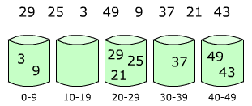
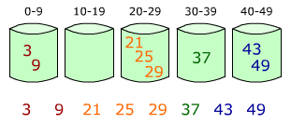

Bucket Sort
Example
Time complexity
Suppose we are sorting $cN$ items and we divide the entire range into $N$ buckets.
Assume that the items are uniformly distributed in the entire range.
The average case time complexity is $O(N)$.
Notes:
On average, each bucket has c items. Treating c as a constant, then sorting the elements in each bucket takes a constant amount of time. The initial assignment and the final readout take O(cN) time.
Show the runtime on the previous slide.

Slide 20
2nd Break
Q&A

Slide 21
Outline
Non-comparison Sort
Counting Sort
Bucket Sort
Radix Sort

Slide 22
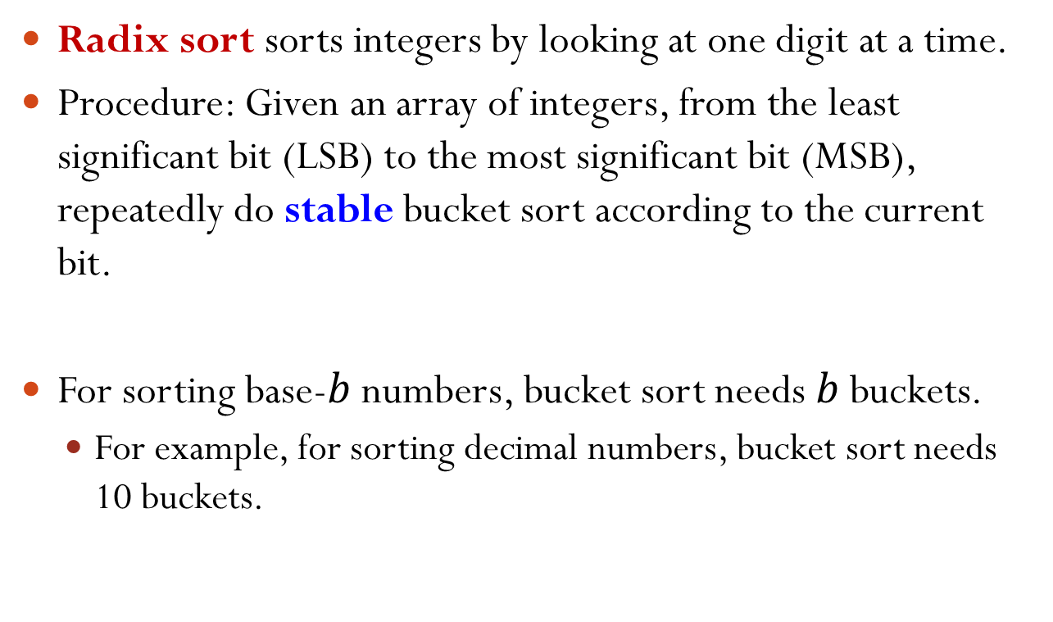
Radix Sort
Radix sort sorts integers by looking at one digit at a time.
Procedure: Given an array of integers, from the least significant bit (LSB) to the most significant bit (MSB), repeatedly do stable bucket sort according to the current bit.
For sorting base-$b$ numbers, bucket sort needs $b$ buckets.
For example, for sorting decimal numbers, bucket sort needs 10 buckets.
Notes:
Note: from the least significant bit (LSB) to the most significant bit (MSB)
Each bucket keeps one digit.

Slide 23
Radix Sort Example
Sort 815, 906, 127, 913, 098, 632, 278.
Bucket sort 815, 906, 127, 913, 098, 632, 278 according to the least significant bit:
Bucket sort 632, 913, 815, 906, 127, 098, 278 according to the second bit.
0 | 1 | 2 | 3 | 4 | 5 | 6 | 7 | 8 | 9
632
913
815
906
127
098
278
Notes:
Note: read the values in order from the first bin to the last bin after sorting

Slide 24
Radix Sort Example
Bucket sort 632, 913, 815, 906, 127, 098, 278 according to the second bit.
Bucket sort 906, 913, 815, 127, 632, 278, 098 according to the most significant bit.
0 | 1 | 2 | 3 | 4 | 5 | 6 | 7 | 8 | 9
906
913
127
632
278
098
815
Notes:
Note in the readout, 913 is before 815.

Slide 25
Radix Sort Example
Bucket sort 906, 913, 815, 127, 632, 278, 098 according to the most significant bit.
The final sorted order is: 098, 127, 278, 632, 815, 906, 913.
0 | 1 | 2 | 3 | 4 | 5 | 6 | 7 | 8 | 9
098
127
278
632
815
906
913

Slide 26
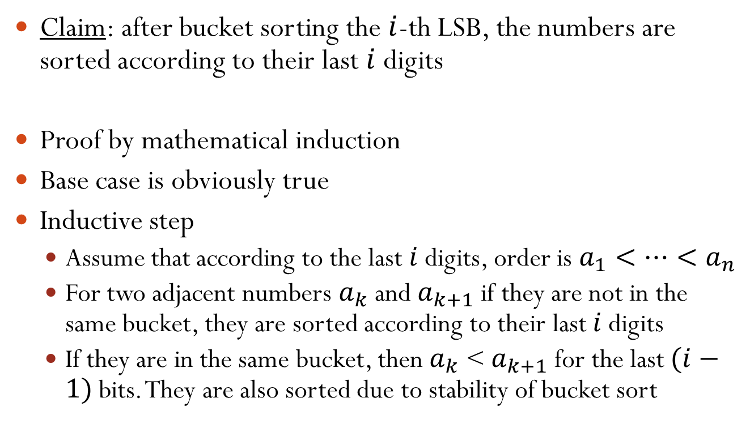
Radix Sort: Correctness
Claim: after bucket sorting the $i$-th LSB, the numbers are sorted according to their last $i$ digits
Proof by mathematical induction
Base case is obviously true
Inductive step
Assume that according to the last $i$ digits, order is $a_{1}<…<a_{n}$
For two adjacent numbers $a_{k}$ and $a_{k+1}$ if they are not in the same bucket, they are sorted according to their last $i$ digits
If they are in the same bucket, then $a_{k}$ < $a_{k+1}$ for the last $(i−1)$ bits. They are also sorted due to stability of bucket sort

Slide 27
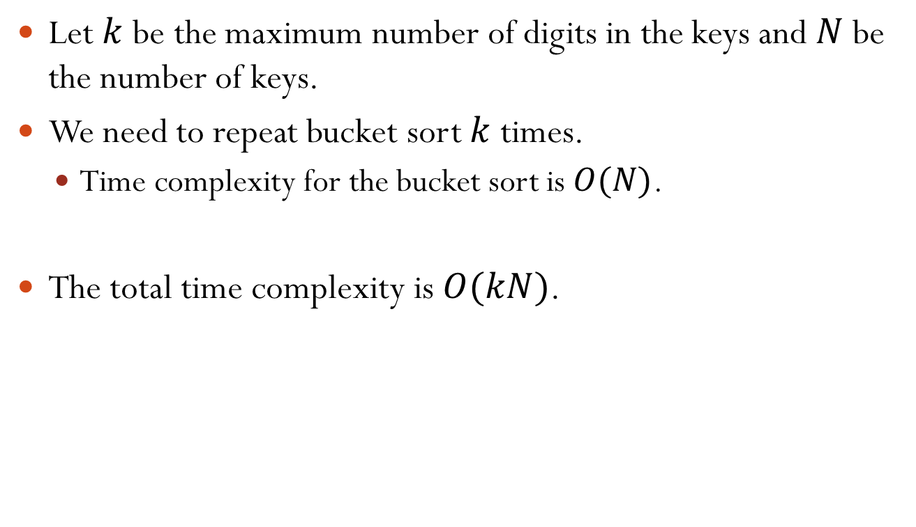
Radix Sort Time Complexity
Let $k$ be the maximum number of digits in the keys and $N$ be the number of keys.
We need to repeat bucket sort $k$ times.
Time complexity for the bucket sort is $O(N)$.
The total time complexity is $O(kN)$.
Notes:
Strictly speaking, the time complexity for bucket sort is O(N+b), where b is the base. However, typically N >> b. Thus, we can ignore b.

Slide 28
Radix Sort
Radix sort can be applied to sort keys that are built on positional notation.
Positional notation: all positions uses the same set of symbols, but different positions have different weight.
Decimal representation and binary representation are examples of positional notation.
Strings can also be viewed as a type of positional notation. Thus, radix sort can be used to sort strings.
We can also apply radix sort to sort records that contain multiple keys.
For example, sort records (year, month, day).

Slide 29
Sharing Time

